Slide 1

Machine Learning in the Housing Market
Project by Tristan Holmes, Daniel Love, and Devin Milligan

Slide 2
Introduction
We Have built a housing tool that takes user input about qualities of a house they are interested in and returns a predicted price based on those inputs using the following tools…
Web Scraping using Beautiful Soup and Splinter
SQLite Databases
Pandas cleaning
Scikit Machine Learning Models
Html and Flask

Slide 3
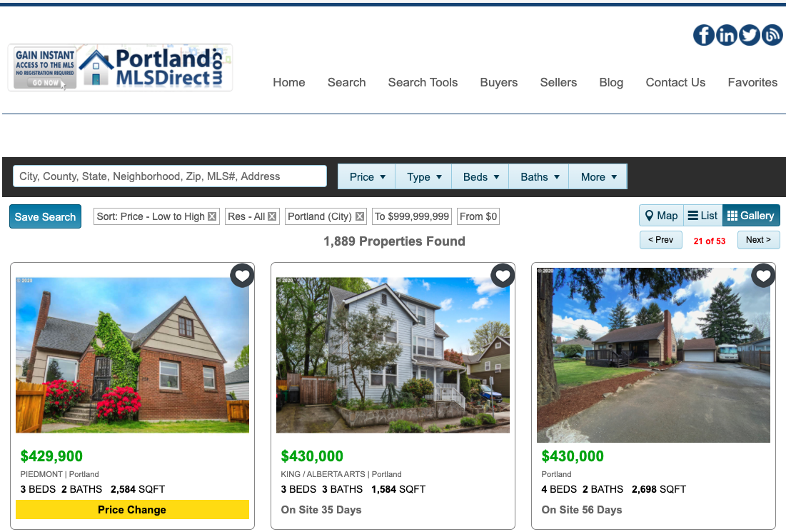
Scraping The Web for Data
First we need Data!
The best route was to scrape the Portland MLS(multiple listing service) website: https://www.portlandmlsdirect.com/

Slide 4
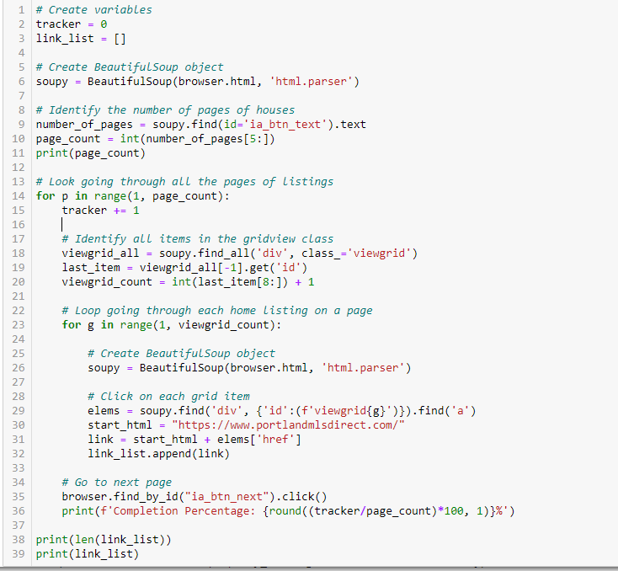
Scraping The Web for Data
Obstacles:
Iterating over 1800+ listings each with their own url.
Grabbing several different data points over inconsistent html structures
Pop-ups! Our “Solutions”:
Create a list of urls (allowed us to scrape only new data on future scrapes)
Try/except and if/else statements to handle inconsistencies
Percentage tracker of scrape in progress (initial scrape took 3+ hrs)

Slide 5
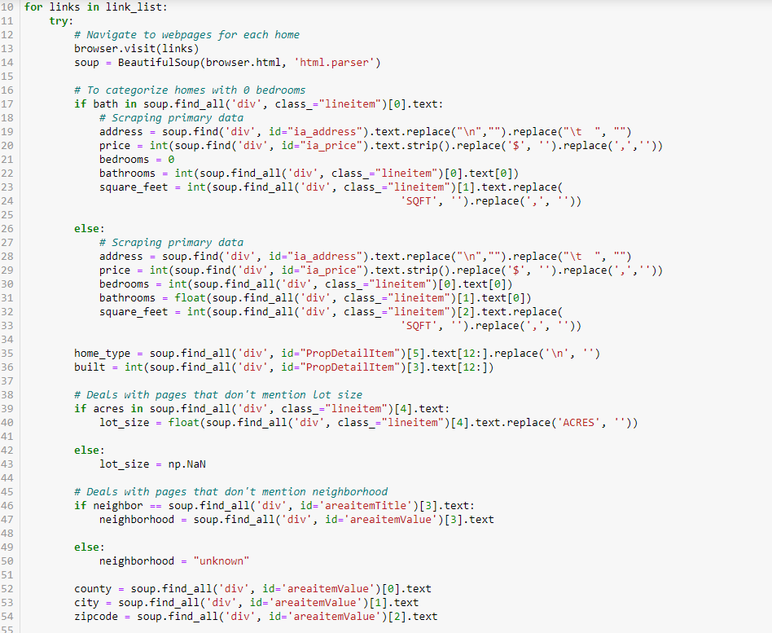
Scraping The Web for Data
Thankfully the format of each page was more or less uniform
There were times where something wasn’t in the same spot as the other pages but we accounted for that
Data was then stored as a csv
Built a rescrape tool that compares current listings on MLS website to previous urls we scraped. Any new url is scraped and stored into our database.
After 3 rescrapes we are up to 2200 points of data

Slide 6
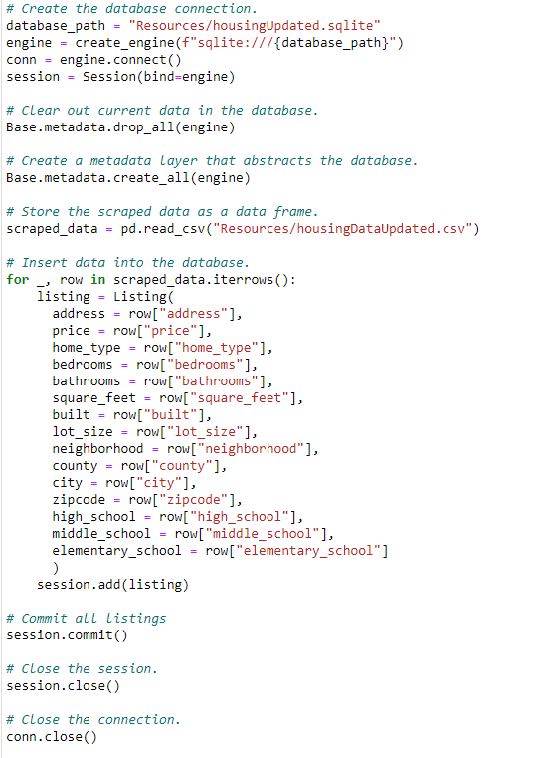
Making a Database
Using the csv that we created from our scraper we made a Sql database for our machine learning model to use later
We used this code with our update scrapes. It allow us to automatically load new listings into database.

Slide 7
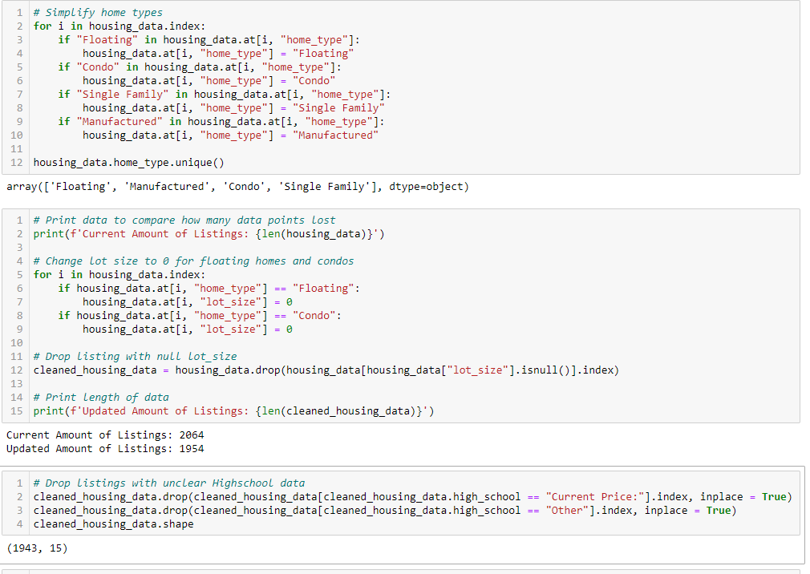
Cleaning Data
After viewing our data we noticed that we were getting some erroneous data
High School held a handful of “Current Price” Entries
The housing types had a lot of sub types which we simplified into four categories
Changed lot size to zero where the house type was floating or condo

Slide 8
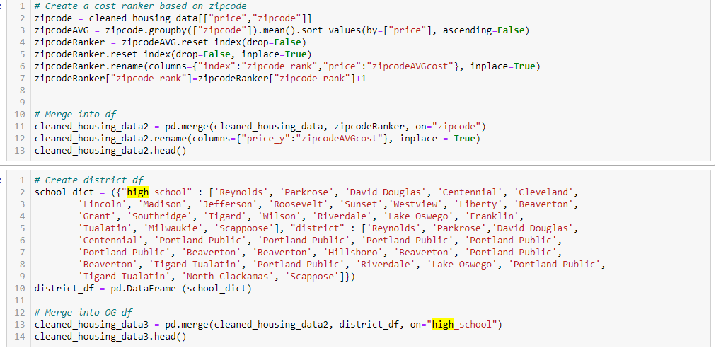
Cleaning Data
Made new data to train the model:
Grouped houses by school district and zipcodes to find average price of homes in those areas
Researched what schools were in what districts and made a district column which we also ranked by mean housing price
Created 5 price bins (ranges) with equal amount of homes in each
With clean data we are ready to use Machine Learning!

Slide 9
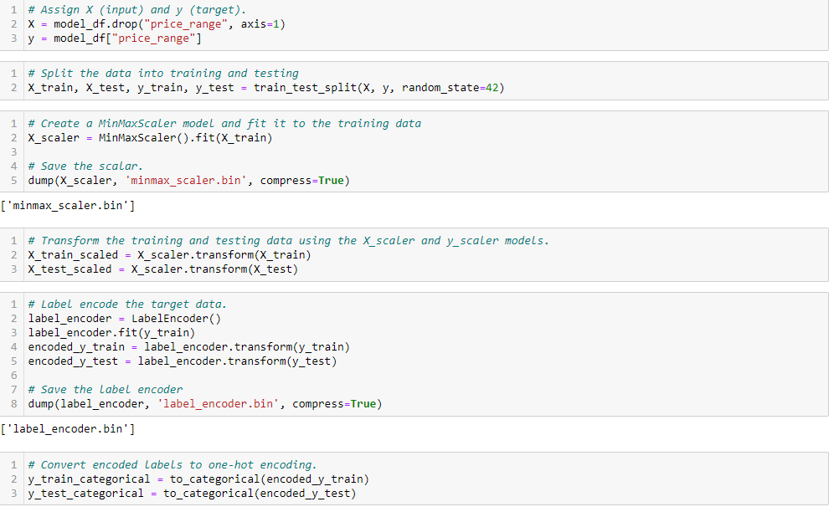
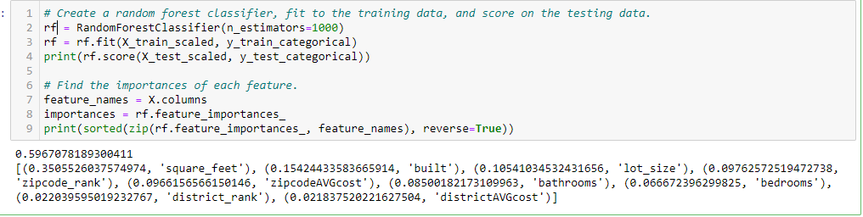
Machine Learning
Split our data into test and train
Then use a Random Forest to determine importance
Unsurprisingly square footage is a significant factor

Slide 10
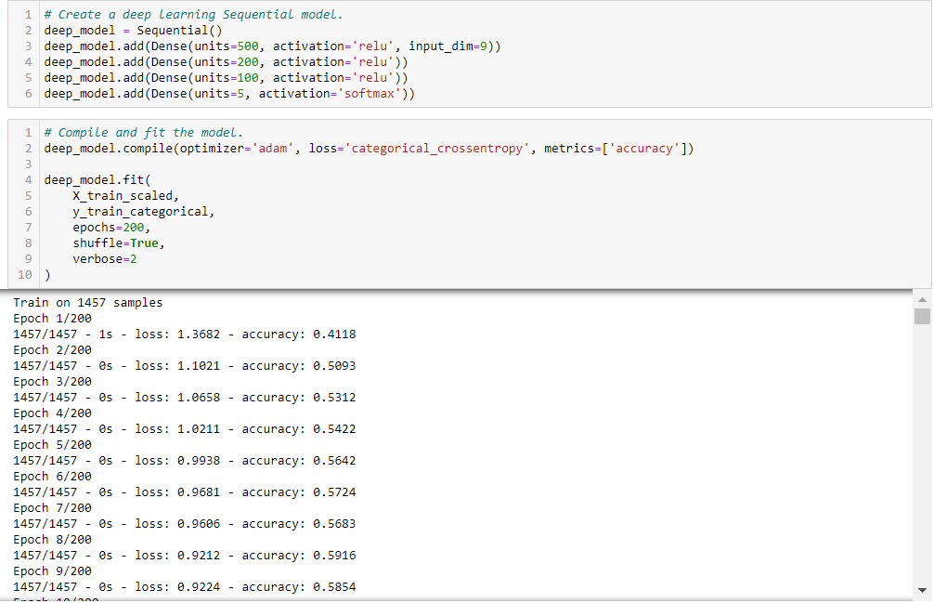

Machine Learning
Deep Learning Model
Our Accuracy started out at about 50 percent but with more data and tweaking our model it is now at 70 percen

Slide 11
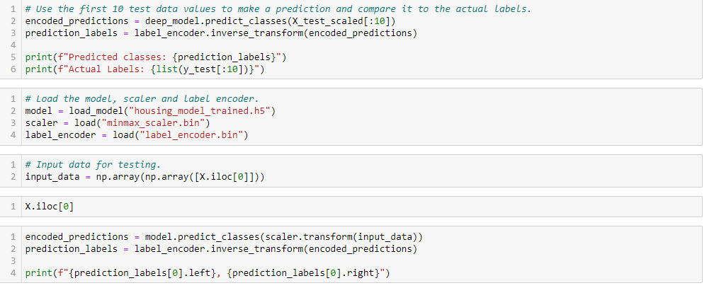
Machine Learning
The Model is ready to predict
And we are ready to introduce it to some html code

Slide 12
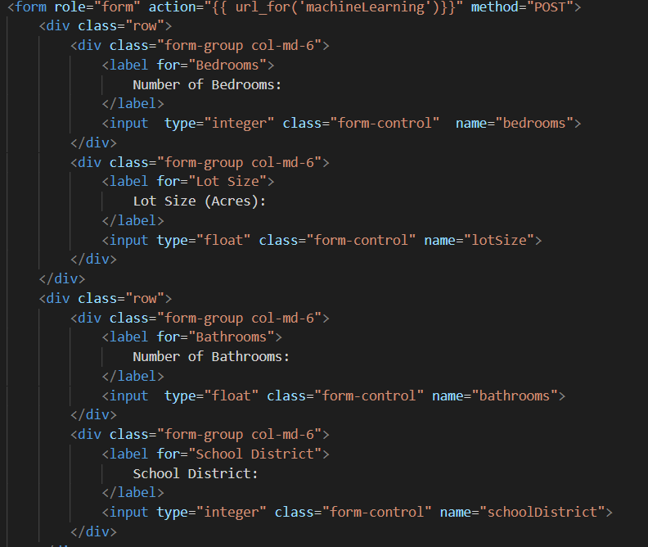
HTML
Used bootstrap to create the bones of the website
Then used the “post method” to store data from the input fields when the submit button was clicked

Slide 13
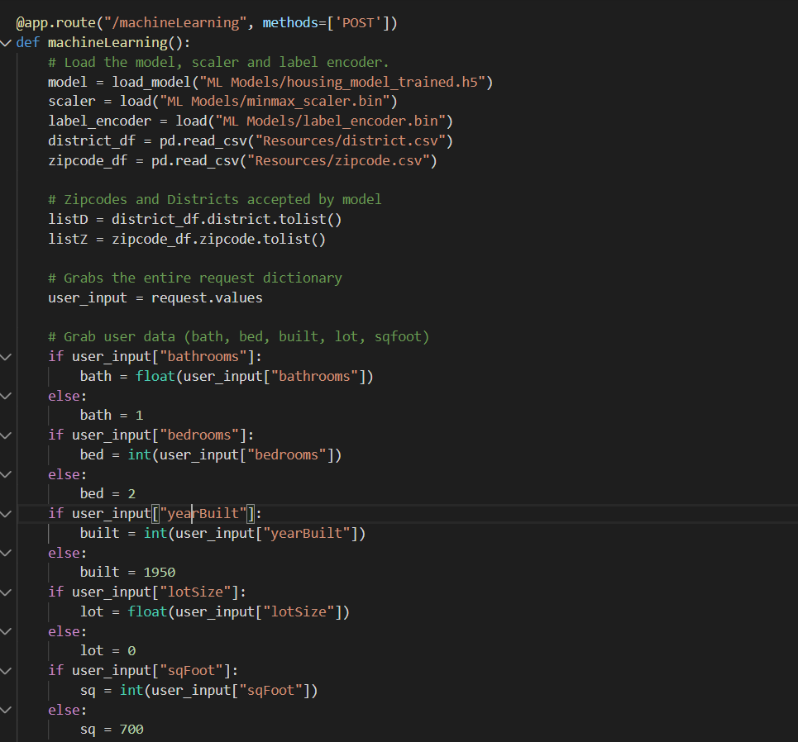
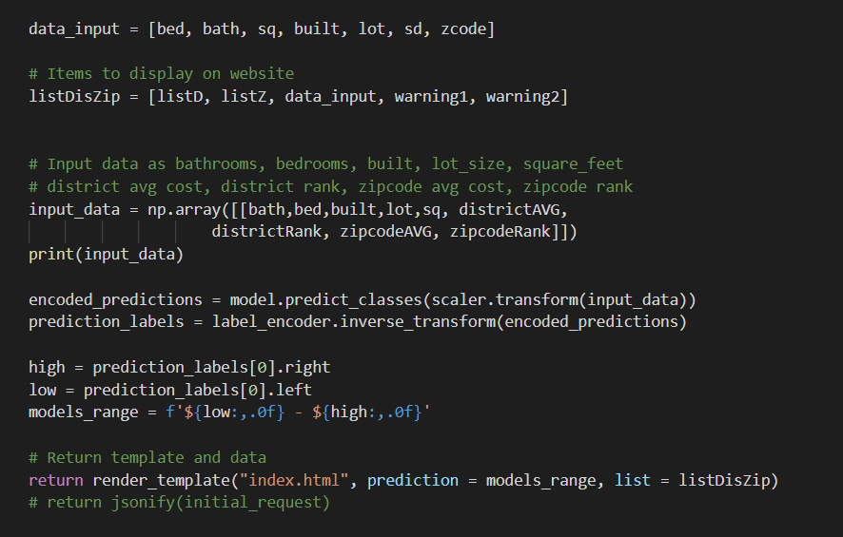
Flask
Once we obtain information input in the fields to our flask app we can run the data through our saved machine learning model.

Slide 14
The Finished Product: (place holder for Heroku link)

Slide 15
Questions?

